Slide 1

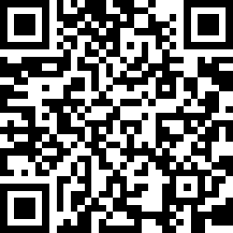
CS2113/T – Lecture 8
Download the L8-Exercises PDF from LumiNUS
Download the UML reference sheet
Have a imaging/scanning app ready on the phone.
Alternatively, you can use a tablet to draw
Submit PDF only
Also, join the session: http://pollev.com/anarayan
This lecture will be recorded
This lecture will be recorded

Slide 2

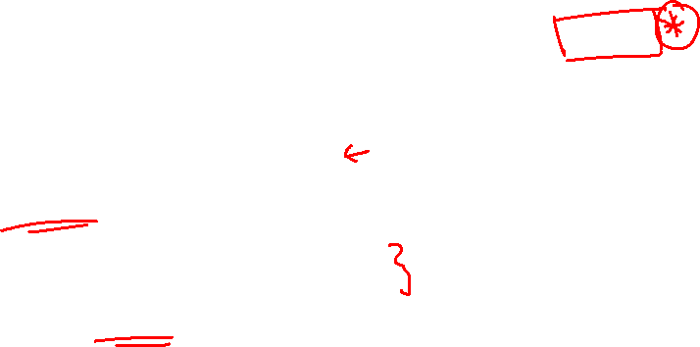
Admin updates
NEWS just in
Final assessment (exam) will be Face To Face, sit in
Time slot will remain the same as announced earlier
Venue will be announced by RO
We will use Examplify for the exam
Format details will be given later
There will be a briefing during a future lecture on how to use Examplify

Slide 3
Q: Choose the correct option
It is the responsibility of the test engineer to ensure all the components are tested right from the beginning
It is the responsibility of the developer to ensure that his/her component is tested right from the beginning (Ans)
It is the responsibility of the user to give bug free requirements so that the product is tested well

Slide 4
Q: You are building a ToDo manager software. It tries to interact with Google calendar, but finds Google servers are down. This should be handled using:
Assertion
Exception (Ans)
Logging
It depends

Slide 5
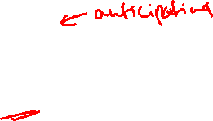
Exceptions Vs Assertions
Serve different purposes
Exceptions – Unusual conditions courtesy user/environment
Assertions – Programmer errors

Slide 6
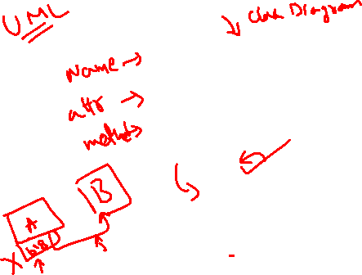
Name
name: String
Person
numPersons: int
getNumPersons():int
Address
lives here
home
Phone
number: String
Labels
Describe the meaning
Associations
Connections between classes/objects
Role
Role played by the object in the association
Navigability
Which class knows about the other

Slide 7
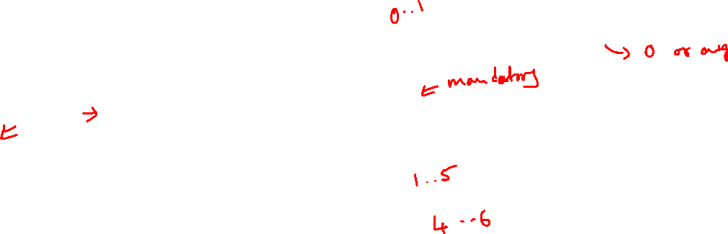
Name
name: String
alias
Person
+ numPersons: int
+ getNumPersons():int
given name
*
1
Address
lives here
home
hand phone
Phone
- number: String
Default is 0 .. 1
Multiplicity
How many objects are involved

Slide 8
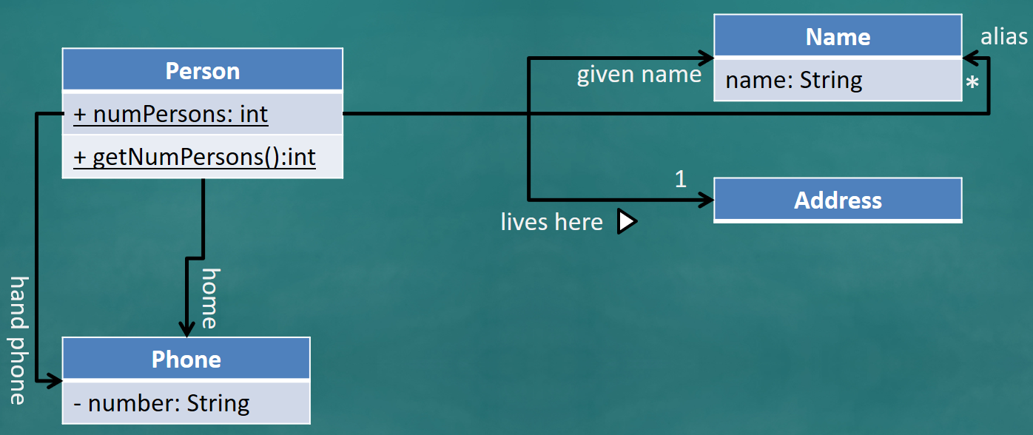
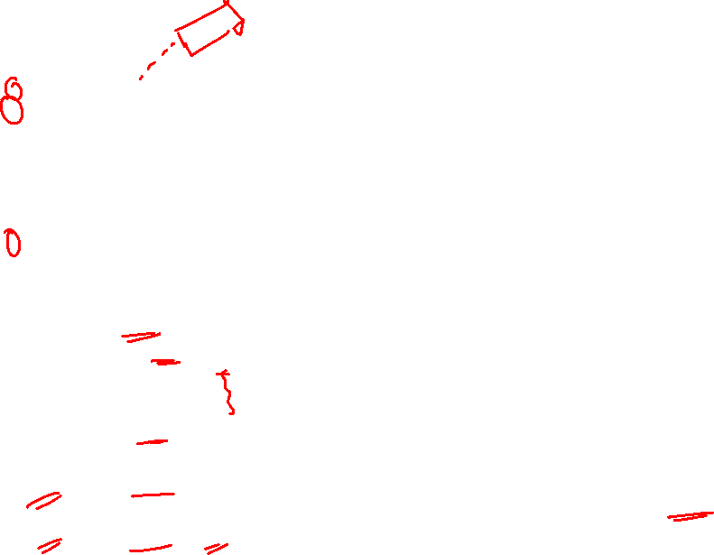
class Name {
String name;
...
}
class Address {
String address;
public Address(String address) {
this.address = address;
}
}
class Person {
Name givenName;
Name [] aliases; // can be ArrayList ...
Phone homePhone;
Phone handPhone;
Address homeAddress;
public static int numPersons = 0;
public static int getNumPersons() { ... }
...
}
class Phone {
private String number;
public String getNumber() { ... }
...
}

Slide 9
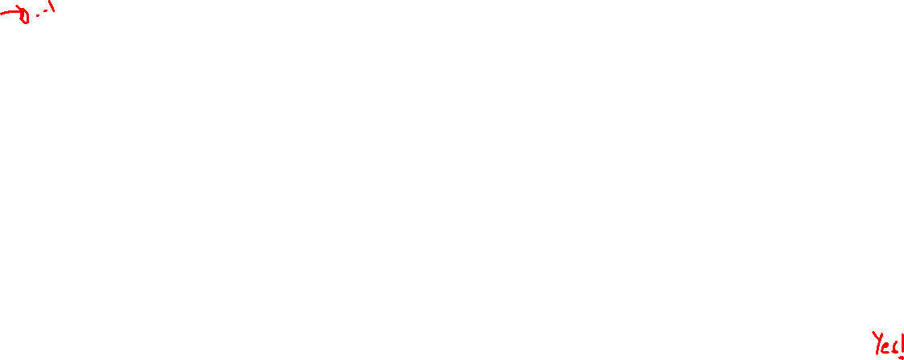
What happens when a person is created in the system?
:Person
homeAddress:Address
Is this a valid state?

Slide 10
Set the given name to be John Doe
John Doe is also called JJ by his friends
John Doe is also called JD in his office
givenName:Name
class Person {
Name givenName;
Name [] aliases; // can be ArrayList ...
Phone home;
Phone handPhone;
Address homeAddress;
public static int numPersons = 0;
public static int getNumPersons() { ... }
...
}
name = “John Doe”
:Person
homeAddress:Address
alias:Name
name = “JJ”
alias:Name
name = “JD”

Slide 11
JJ changed his home address to a different address, address2
givenName:Name
Associations in the object structure can change over time
address2:Address
name = “John Doe”
:Person
homeAddress:Address
alias:Name
name = “JJ”
alias:Name
name = “JD”

Slide 12
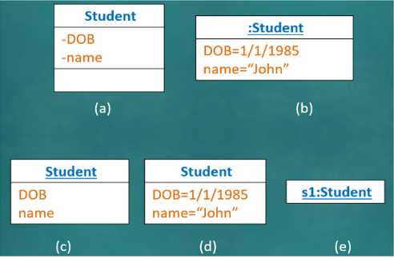
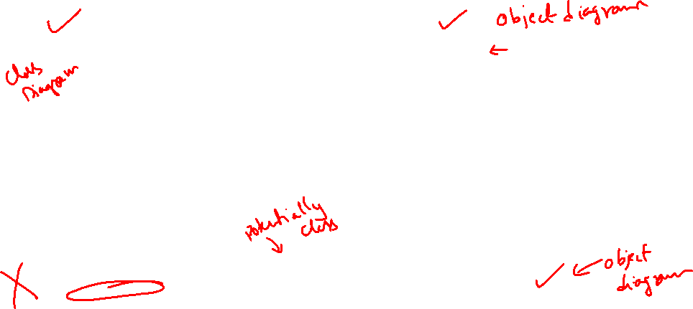

Slide 13
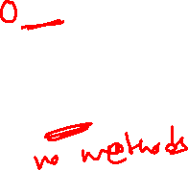
Class Vs Object diagram
ClassName
:ClassName
Attributes
Attribute=value
Optional
Methods

Slide 14
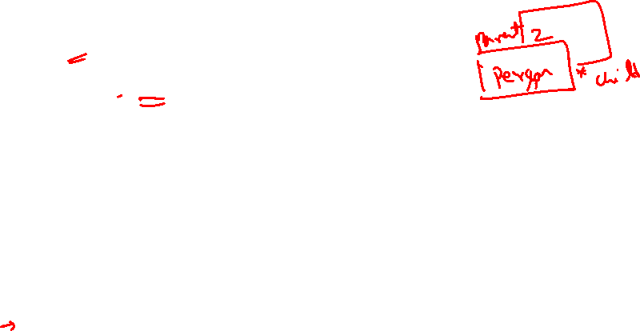
2
Foo
bar
*
(a)
(b)
:Foo
:Foo
bar
bar
bar
:Foo
:Foo
:Foo
:Foo
Which object diagram is compliant with the given class diagram?

Slide 15
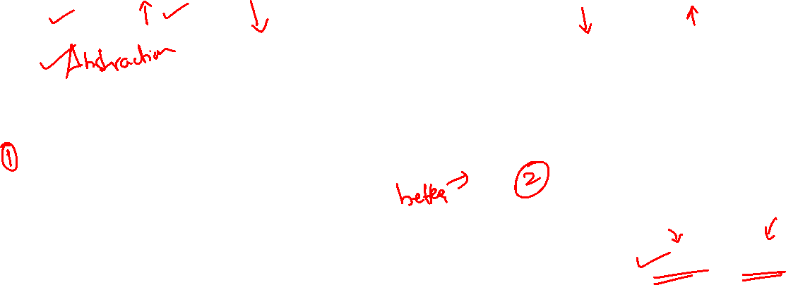
Design fundamentals
Coupling
Cohesion
Coupling
Cohesion
Writes user input to data
Passes user input to Logic
WebUI
WebUI
Logic
Logic
SRP / SOC
DataStore
DataStore

Slide 16
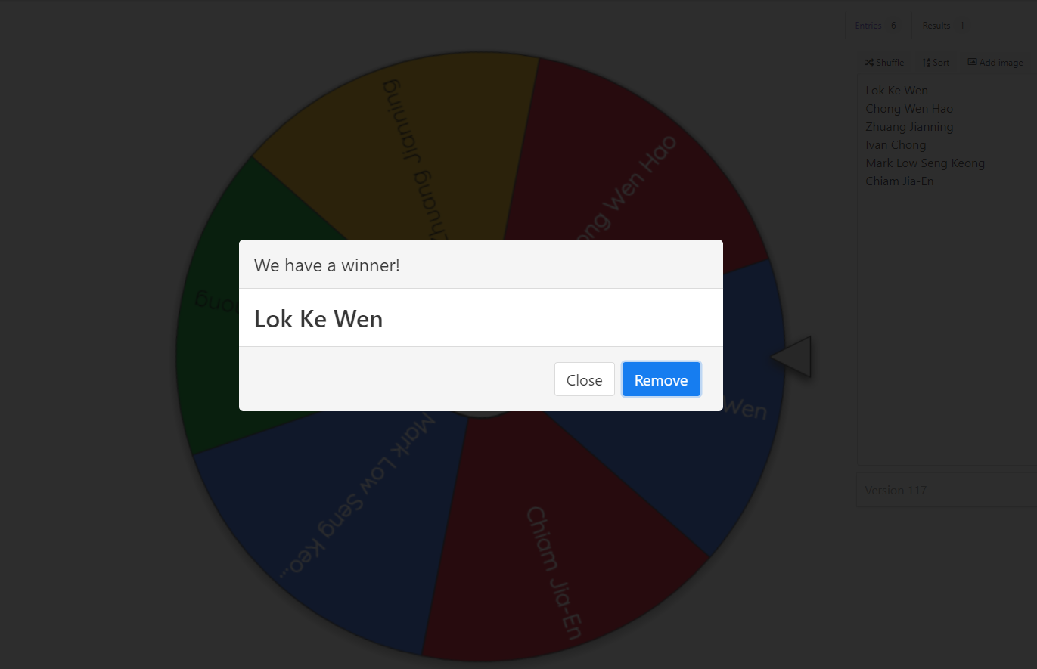
Spin the wheel!

Slide 17


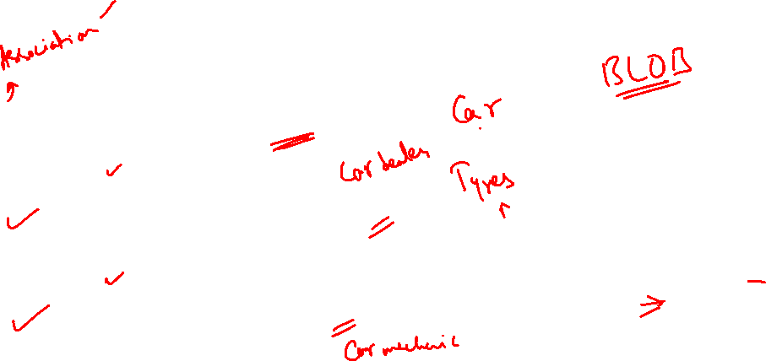
Composition
Dependency
Aggregation

Slide 18
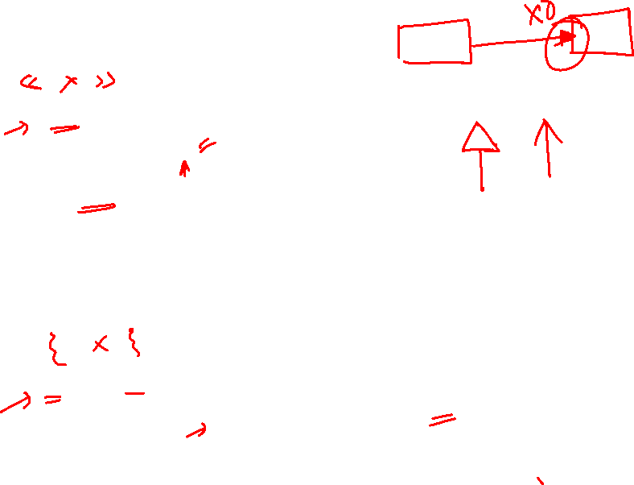
Abstract class/method
UGStudent
register()
*
{abstract}
Student
Admin
NGStudent
register()
register(){abstract}
{abstract}
PGStudent
Inheritance
Interfaces
Person
<<interface>>
Debtor
<<interface>>
Graded
<<interface>>
Client
<<interface>>
Payee
Student
Different colors don’t mean anything here!

Slide 19
Student
Book
borrows
Where to put return date?

Slide 20

Student
Book
borrows
Student
Book
borrows
Loan
Association classes
returnDate

Slide 21
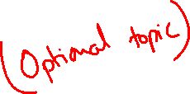
Student
Book
borrows
Student
Book
borrows
Loan
Association classes
returnDate
Student
Book
Loan
returnDate

Slide 22
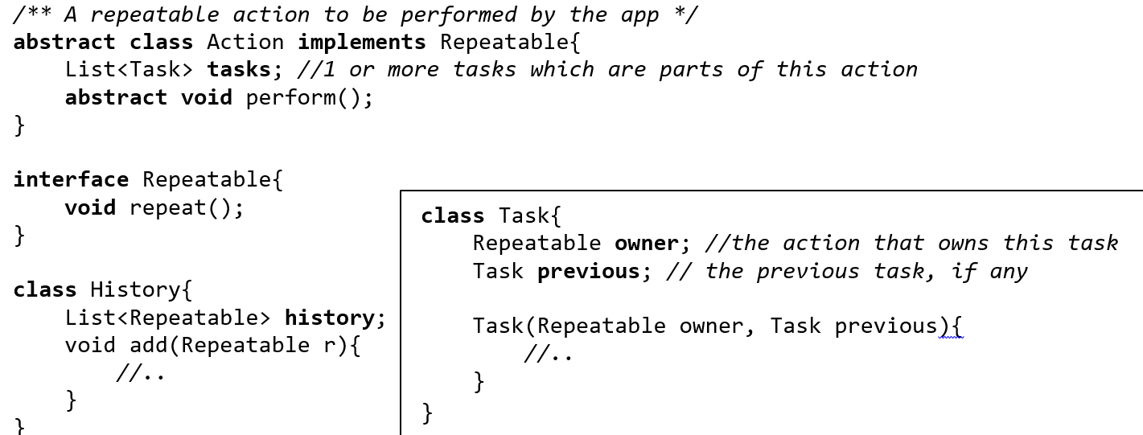
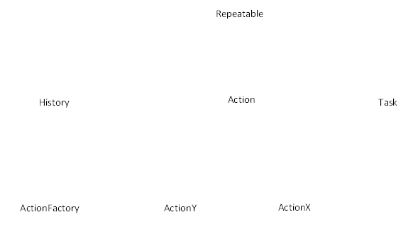

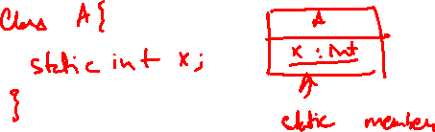



Submissions are not graded as such; will use it for cushioning your participation marks, if necessary
Q: [4 marks] Illustrate the class structure of the following code using a suitable UML diagram. In addition to the classes in the code, include the following classes:
ActionX, ActionY: Inherits from the Action class.
ActionFactory: creates ActionX, ActionY objects and adds them to the History object.
Show all associations as lines. Show attributes, methods, navigabilities, dependencies and known multiplicities.
Other optional notations can be used only when they add value. Draw the diagram by filling out the missing parts of the skeletal diagram given

Slide 23
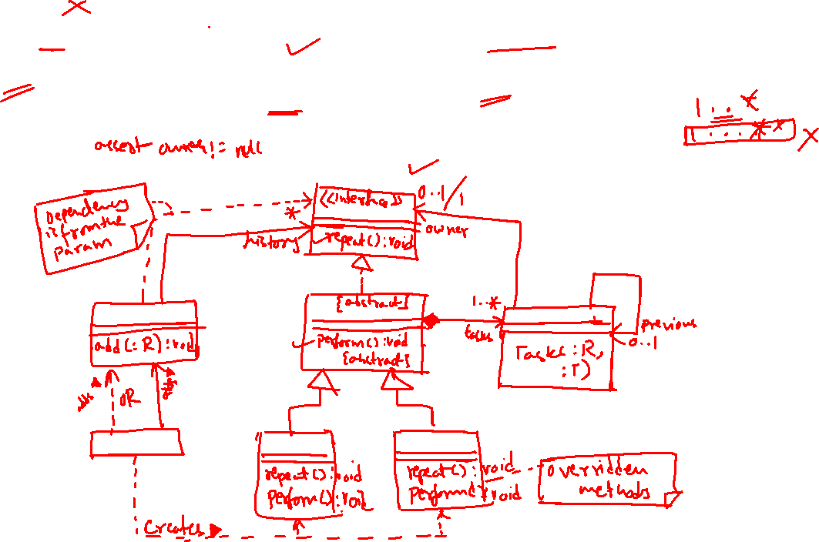
ActionX, ActionY: Inherits from the Action class.
ActionFactory: creates ActionX, ActionY objects and adds them to the History object.
Grading aspects:
Decorators (abstract/interface)
Majority of associaions
Multiplicities
Roles
Labels
Concrete methods in ActionX/ActionY
Implements/Extends
Missing classes written correctly

Slide 24
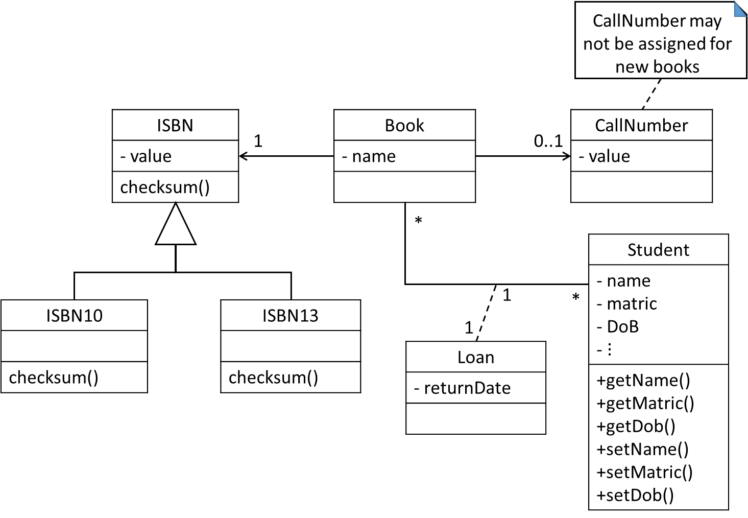
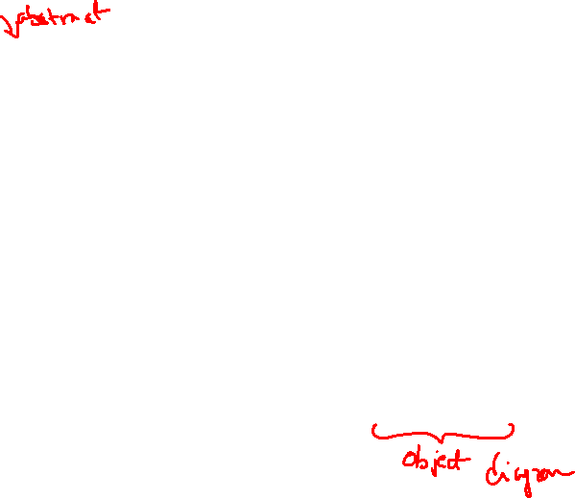
Consider the library management system (LMS) in the university implemented as shown in the class diagram below. Answer part (a) and (b) based on this class diagram
“Tarzan (a student) borrows a new copy of JungleBook with : ISBN13: 978-0123456789 and Beauty and the Beast with call number FC999c.1. JungleBook has to be returned within 1 week, by November 29, 2019. Beauty and the Beast, however, can be returned on December 23, 2019.” Draw an appropriate UML diagram representing the state of the system after Tarzan borrows the books. ISBN is abstract

Slide 25

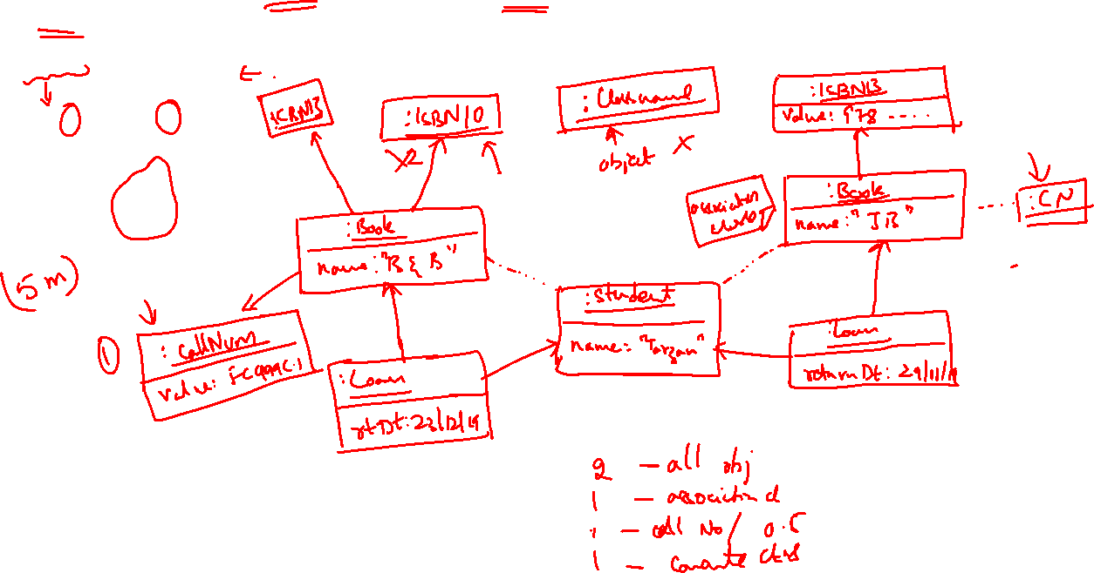

“Tarzan (a student) borrows a new copy of JungleBook with : ISBN13: 978-0123456789 and Beauty and the Beast with call number FC999c.1. JungleBook has to be returned within 1 week, by November 29, 2019. Beauty and the Beast, however, can be returned on December 23, 2019.” Draw an appropriate UML diagram representing the state of the system after Tarzan borrows the books. ISBN is abstract

